Slide 1
Vector exercises

Slide 2
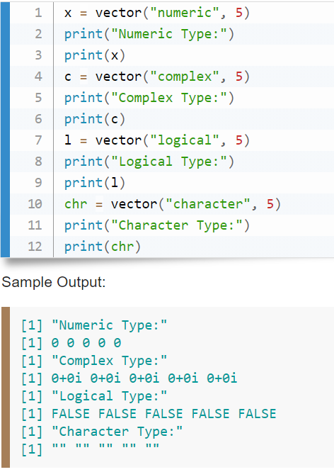
Write a R program to create a vector of a specified type and length. Create vector of numeric, complex, logical and character types of length 5.

Slide 3
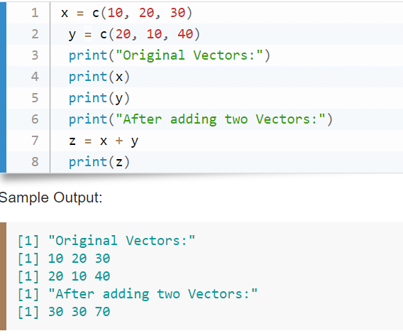
Write a R program to add two vectors of integers type and length 3.

Slide 4
Write a R program to multiply two vectors of integers type and length 3.
x = c(10, 20, 30)
y = c(20, 10, 40)
print("Original Vectors:")
print(x)
print(y)
print("Product of two Vectors:")
z = x * y
print(z)
Output
[1] 200 200 1200

Slide 5
Write a R program to divide two vectors of integers type and length 3.
x = c(10, 20, 30)
y = c(20, 10, 40)
print("Original Vectors:")
print(x)
print(y)
print("After dividing Vectors:")
z = x / y
print(z)
Sample Output:
[1] "Original Vectors:“
[1] 10 20 30
[1] 20 10 40 [1]
"After dividing Vectors:"
[1] 0.50 2.00 0.75

Slide 6
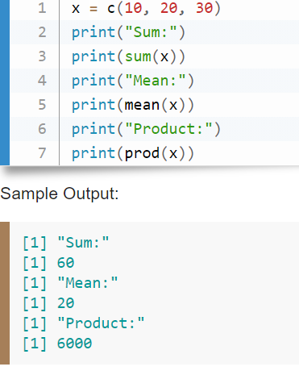
Write a R program to find Sum, Mean and Product of a Vector.

Slide 7
Write a R program to find the minimum and the maximum of a Vector.
x = c(10, 20, 30, 25, 9, 26}
print("Original Vectors:")
print(x)
print("Maximum value of the above Vector:")
print(max(x) )
print("Minimum value of the above Vector:")
print(min(x))
Sample Output:
[1] "Original Vectors:“
[1] 10 20 30 25 9 26
1] "Maximum value of the above Vector:“
[1] 30
[1] "Minimum value of the above Vector
[1] 9 (

Slide 8
Write a R program to reverse the order of given vector.
v= c(0, 10, 10, 10, 20, 30, 40, 40, 40, 50, 60)
print("Original vector-1:")
print(v)
rv = rev(v)
print("The said vector in reverse order:")
print(rv)
Sample Output:
[1] "Original vector-1:"
[1] 0 10 10 10 20 30 40 40 40 50 60
[1] "The said vector in reverse order:"
[1] 60 50 40 40 40 30 20 10 10 10 0

Slide 9
Write a R program to sort a Vector in ascending and descending order
x = c(10, 20, 30, 25, 9, 26)
print("Original Vectors:")
print(x)
print("Sort in ascending order:")
print(sort(x))
print("Sort in descending order:")
print(sort(x, decreasing=TRUE))
Copy
Sample Output:
[1] "Original Vectors:"
[1] 10 20 30 25 9 26
[1] "Sort in ascending order:"
[1] 9 10 20 25 26 30
[1] "Sort in descending order:"
[1] 30 26 25 20 10 9

Slide 10
Write a R program to test whether a given vector contains a specified element
x = c(10, 20, 30, 25, 9, 26)
print("Original Vectors:")
print(x)
print("Test whether above vector contains 25:")
print(is.element(25, x))
print("Test whether above vector contains 56:")
print(is.element(56, x))
Copy
Sample Output:
[1] "Original Vectors:"
[1] 10 20 30 25 9 26
[1] "Test whether above vector contains 25:"
[1] TRUE
[1] "Test whether above vector contains 56:"
[1] FALSE

Slide 11
Write a R program to concatenate a vector.
a = c("Python","NumPy", "Pandas")
print(a)
x = paste(a, collapse = "")
print("Concatenation of the said string:")
print(x)
Sample Output:
[1] "Python" "NumPy" "Pandas"
[1] "Concatenation of the said string:"
[1] "PythonNumPyPandas"

